Slide 1

Pitcher X Analysis

Slide 2
PDF Report

Slide 3
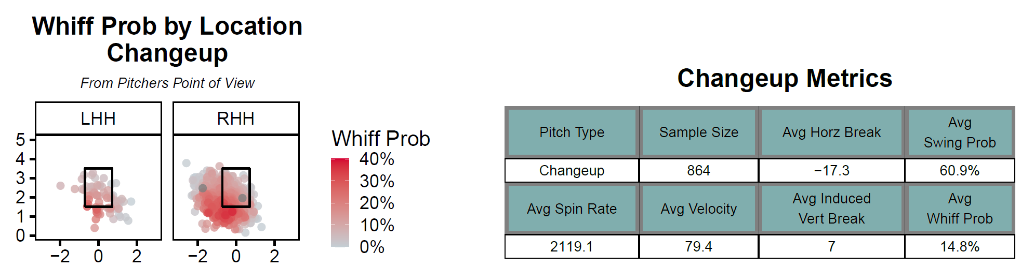
Changeup

Slide 4
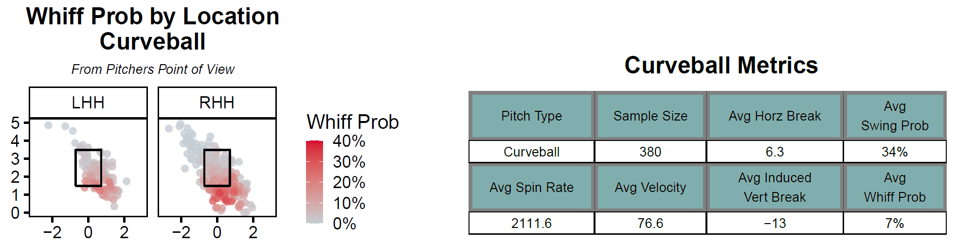
Curveball

Slide 5
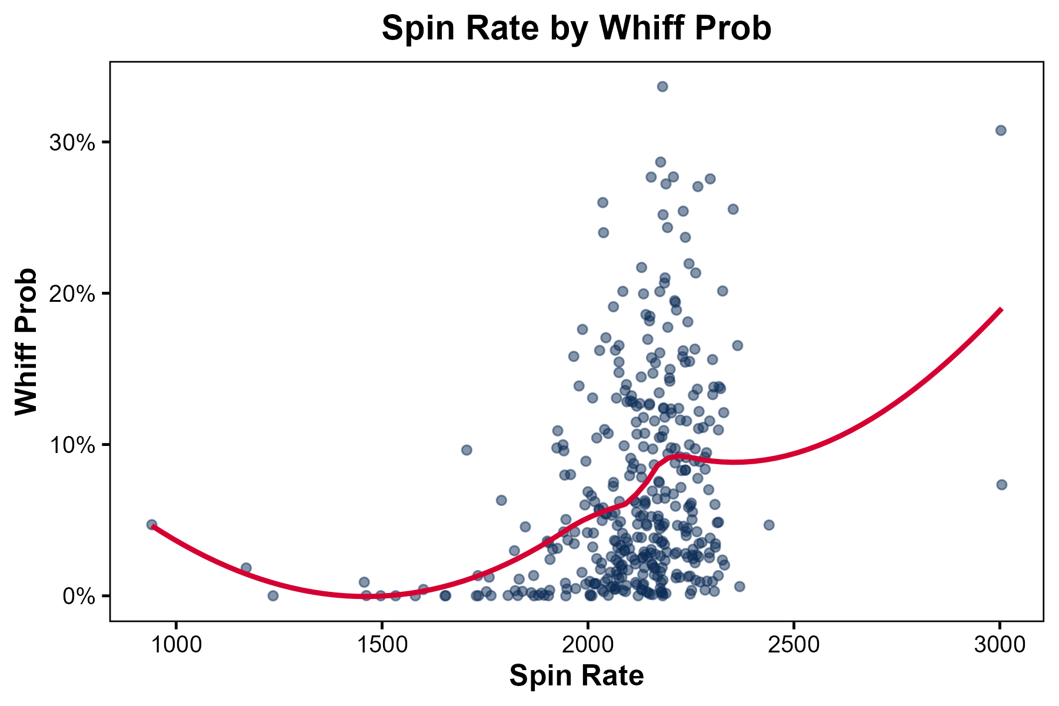
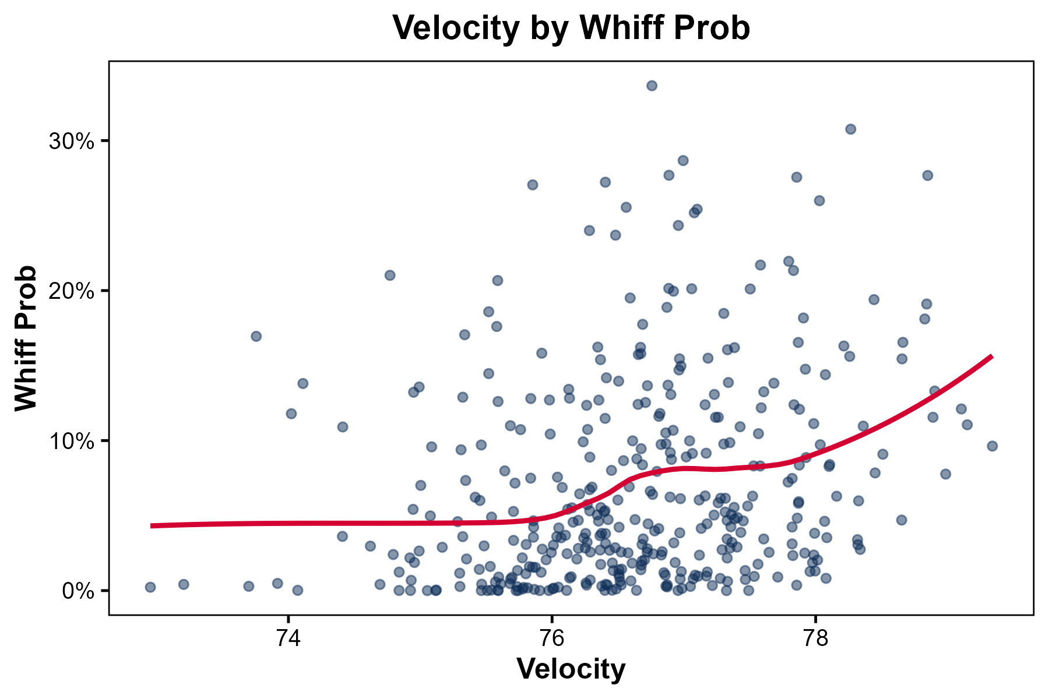
Curveball
Spin Rate ↑ = Whiff Probability ↑
Velocity↑ = Whiff Probability ↑

Slide 6
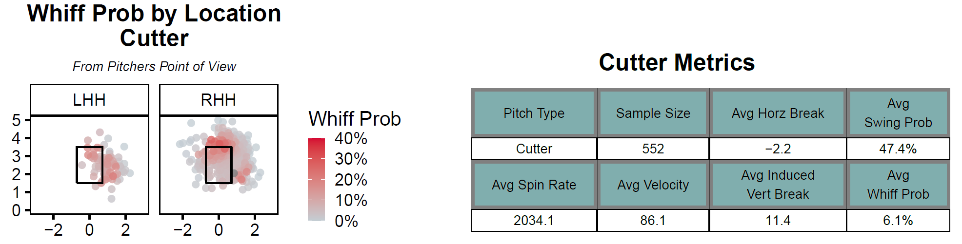
Cutter

Slide 7
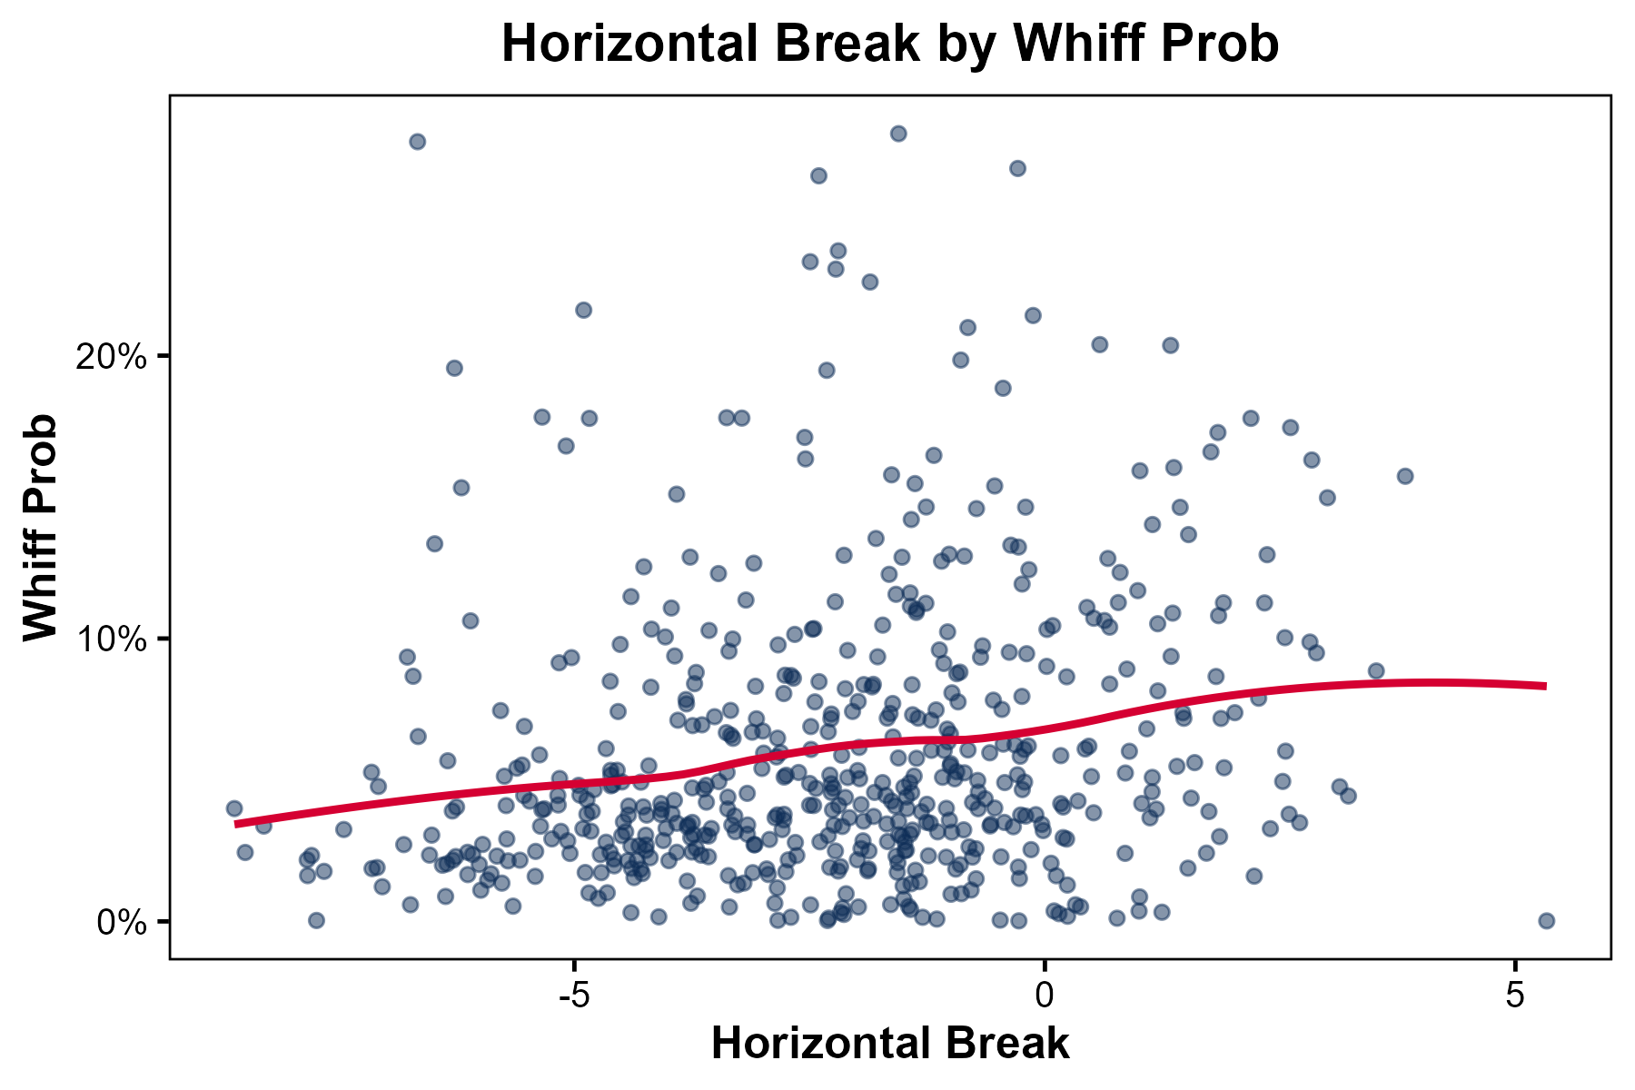
Curveball
Horizontal Break ↑ = Whiff Probability ↑

Slide 8
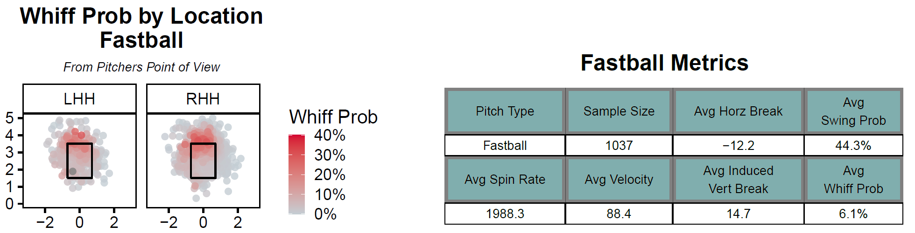
Fastball

Slide 9
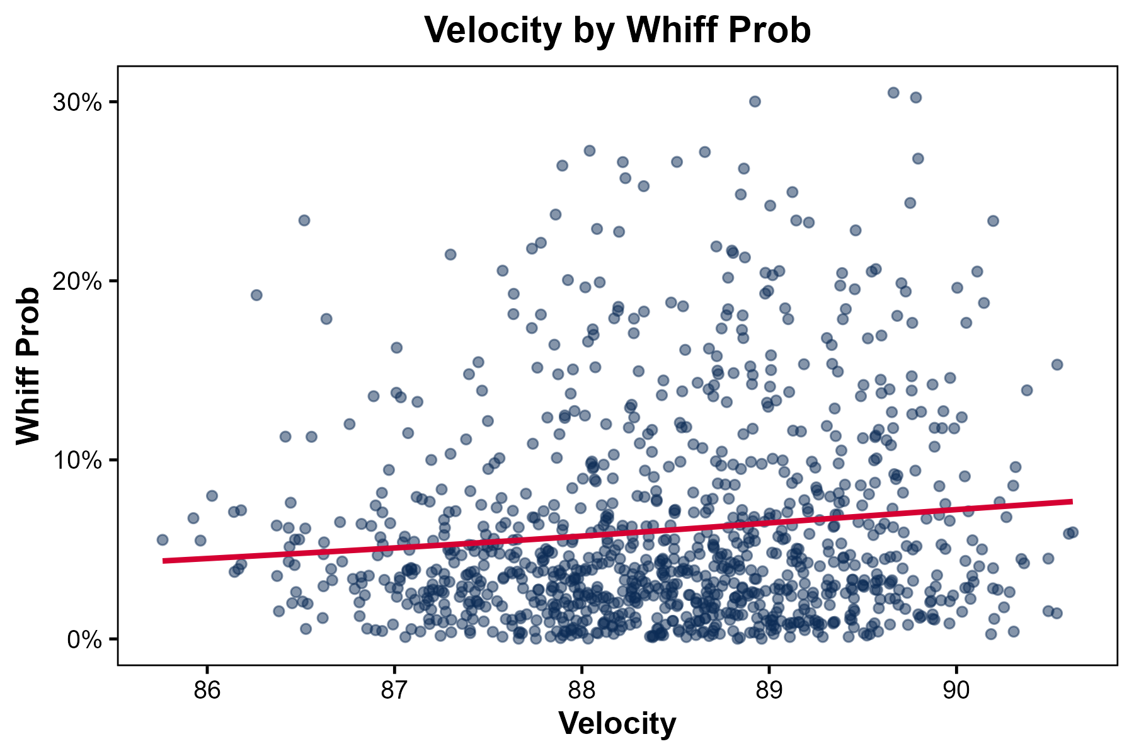
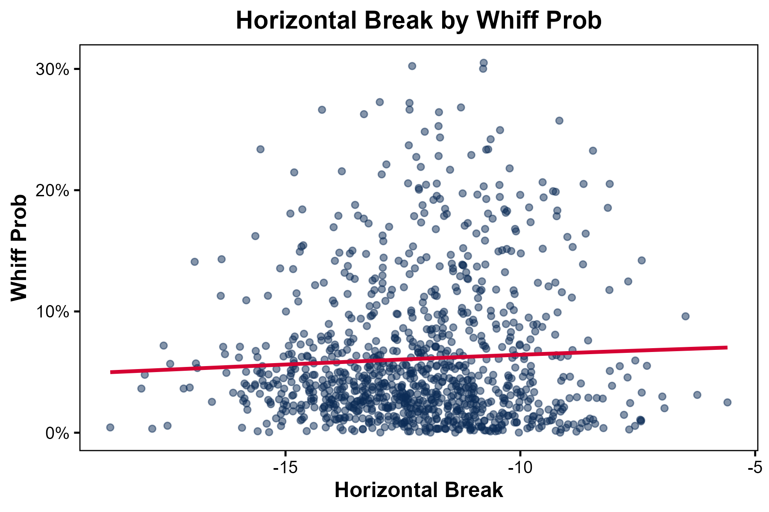
Fastball
Velocity↑ = Whiff Probability ↑
Horizontal Break ↑ = Whiff Probability ↑

Slide 10
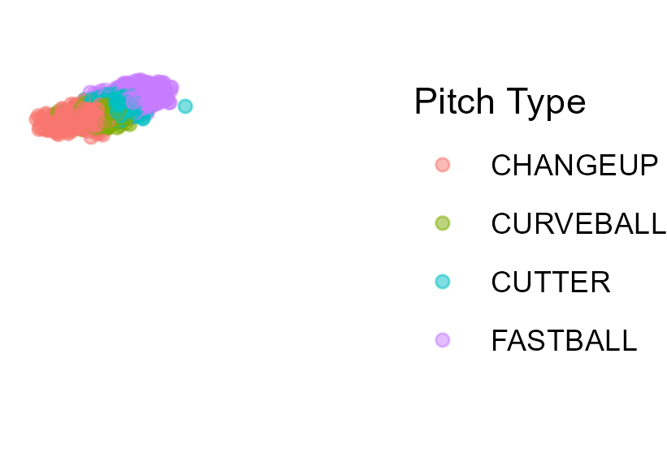


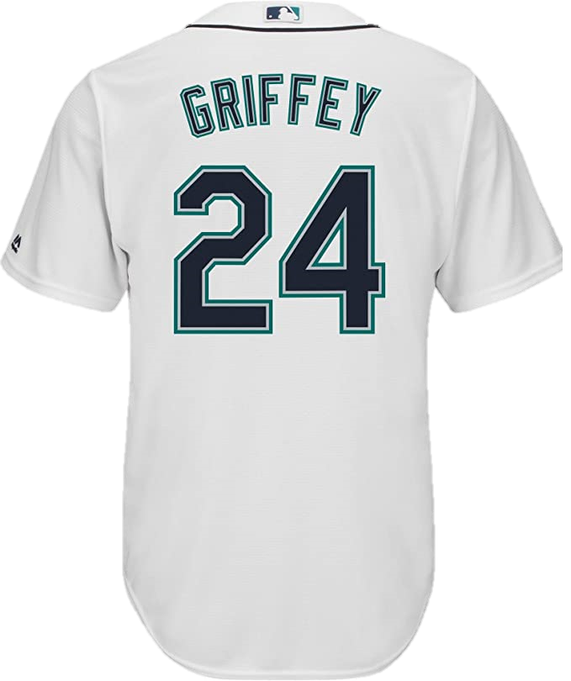
Differences Between Pitches
Arm Slots
Throwing it ↑ direction

